Slide 1
Digital Portfolio
STUDENT NAME: Jenis T
REGISTER NO AND NMID: asbru092422k2248 , 4BAB7C38C369EB4B0504631B8FD9F5E1
DEPARTMENT: B.s.c Computer Science
COLLEGE: GOVERMENT ARTS COLLEGE UDUMALPET - BHARATHIYAR UNIVERSITY

Slide 2
Portfolio :
My portfolio showcases a blend of creativity, technical skill, and attention to detail. It highlights projects that reflect my passion for Front end development and my ability to bring ideas to life through clean, functional, and aesthetically pleasing solutions. Each project demonstrates not just what I can build, but how I approach problems, innovate, and continuously refine my craft.

Slide 3


AGENDA
Problem Statement
Project Overview
End Users
Tools and Technologies
Portfolio design and Layout
Features and Functionality
Results and Screenshots
Conclusion
Github Link
3/21/2024 Annual Review

Slide 4

PROBLEM STATEMENT
As a computer science student entering a competitive field, there is a critical need for a centralized, professional, and visually appealing online presence. A simple resume is often not enough to showcase practical skills and personality. The problem is the absence of a dedicated platform to effectively present my technical abilities, project work, and personal brand to potential employers, professors, and collaborators.

Slide 5

PROJECT OVERVIEW
This project involves the creation of a personal portfolio website for myself, Jenis T. It is a single-page application designed to serve as a dynamic and interactive digital resume. The website introduces who I am, details my current technical skillset, showcases my key project (the Oppenheimer Tribute Page), and provides clear channels for contact. The primary goal is to create a memorable first impression and provide a comprehensive overview of my qualifications.

Slide 6

WHO ARE THE END USERS?
The portfolio is designed for a few key audiences:
Technical Recruiters & Hiring Managers: They need a quick, scannable overview of my skills and a link to tangible work.
Professors & Academic Mentors: They may use it to gauge my practical application of concepts learned in coursework.
Peers & Potential Collaborators: They can see my interests and development style, opening doors for collaboration.

Slide 7
TOOLS AND TECHNIQUES
The portfolio was built using foundational and modern web technologies to ensure performance, aesthetics, and maintainability:
Frontend: HTML5, CSS3
Design & Theme: The aesthetic is based on the Rosé Pine dark color palette.
UI Effects: A Glassmorphism effect is used on cards to create depth and a modern feel.
Typography: Google Fonts (specifically 'Poppins') is used for clean and readable text.
Icons: Boxicons, a lightweight icon library, is integrated for crisp and consistent iconography.

Slide 8
POTFOLIO DESIGN AND LAYOUT
The design philosophy is minimalist, aesthetic, and user-centric.
Layout: A single-page, vertical-scrolling layout ensures a seamless and uninterrupted user experience.
Visual Theme: The Rosé Pine theme provides a warm, elegant, and comfortable viewing experience that is easy on the eyes.
Hierarchy: Information is structured logically, starting with a bold introduction (Hero Section), followed by deeper context (About, Skills), proof of work (Projects), and a call to action (Contact).
Dynamic Elements: Subtle animations, such as the floating profile picture and background blobs, add a touch of personality and visual interest without being distracting.
‹#›

Slide 9
FEATURES AND FUNCTIONALITY
The portfolio incorporates several key features to be both informative and engaging:
Responsive Design: The layout is fully responsive, providing an optimal viewing experience on desktops, tablets, and mobile devices.
Interactive Hero Section: An engaging introduction featuring my name, title, and a high-quality profile picture.
Organized Skill Showcase: Skills are categorized into "Languages" and "Concepts & Tools," each accompanied by relevant icons for quick recognition.
Detailed Project Card: My Oppenheimer project is presented in a clean card format with technology tags and a direct, icon-led link to the live project.
Actionable Contact Links: The contact section includes a direct mailto: link for email and icon links to my professional profiles on GitHub and LinkedIn.

Slide 10
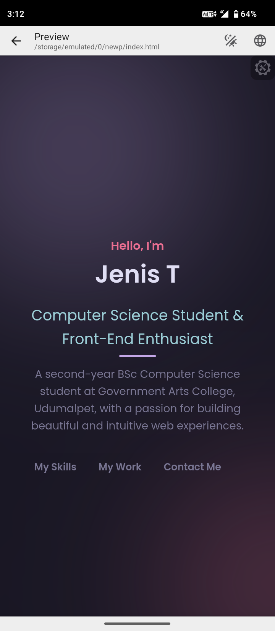
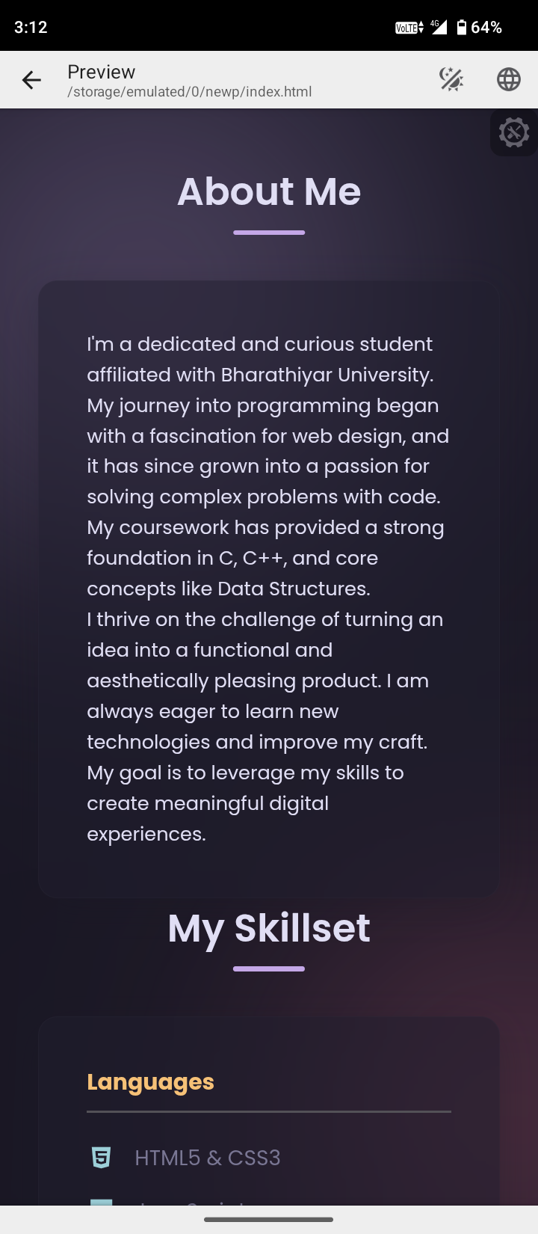
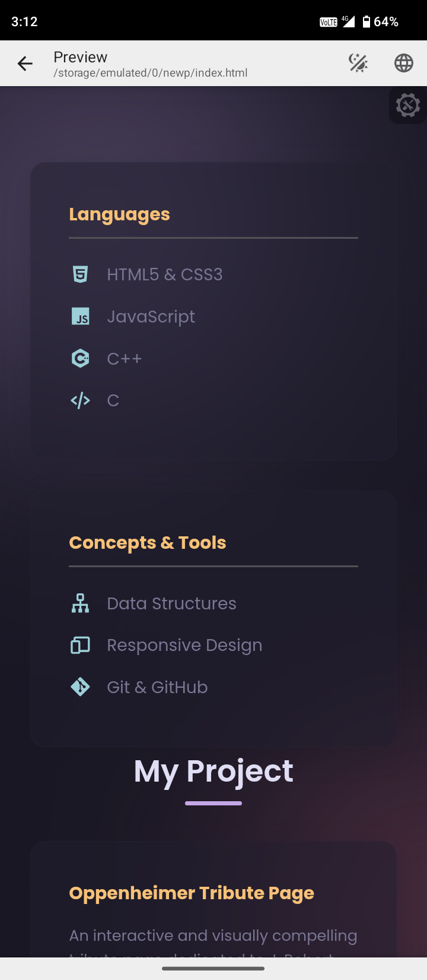

RESULTS AND SCREENSHOTS
3/21/2024 Annual Review
‹#›

Slide 11
CONCLUSION
This portfolio project successfully meets the initial problem statement by creating a strong, centralized online presence. It effectively showcases my technical skills and project experience in a modern, aesthetic, and accessible format. It serves not only as a digital resume but also as a foundation that can be easily expanded with new projects and skills as I continue my journey in computer science.
‹#›

